Slide 1

Neural Networks and Deep Learning Professional Elective –III ( PE850IT)
Presented by
Dr. T. Hitendra Sarma
Associate Professor
Department of Information Technology
Vasavi College of Engineering, Hyderabad

Slide 2
Outline
Recap – Perceptron
Limitations of Perceptron
Multi Layer Perceptron
MLP as Boolean Function
MLPs as universal classifiers

Slide 3
Outline…
Multi-layer Perceptrons as universal Boolean functions
– The need for depth
MLPs as universal classifiers
– The need for depth
MLPs as universal approximators
A discussion of optimal depth and width
Brief segue: RBF networks
68

Slide 4
Acknowledgements
The content used in this presentation is extracted from the handouts of the course on “Introduction to Deep Learning” by Dr Bhiksha Raj, Carnegie Mellon University.
As the instructor of NNDL Course, I sincerely thank Dr Bhiksha Raj and Carnegie Mellon University for making this valuable learning resources for ethical usage for teaching and learning.
I highly recommend all my students to follow https://www.youtube.com/channel/UC8hYZGEkI2dDO8scT8C5UQA
for more valuable information for learning materials and video
lectures.
4

Slide 5

Recap : NNets and the brain
In their basic form, NNets mimic the networked structure in the brain
5

Slide 6

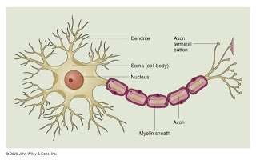
Recap : The brain
The Brain is composed of networks of neurons
6

Slide 7
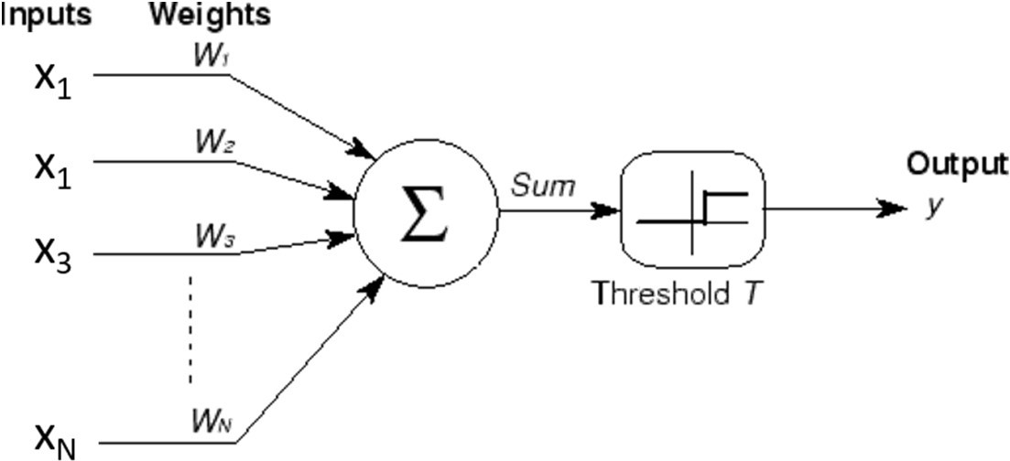
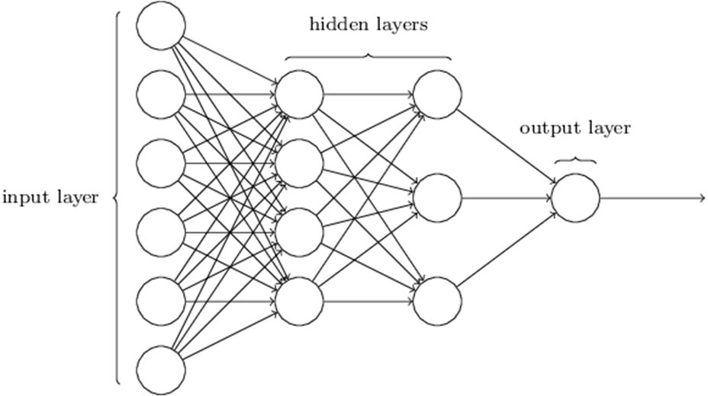

Recap : Nnets and the brain
Neural nets are composed of networks of computational models of neurons called perceptrons
7

Slide 8
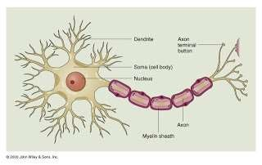
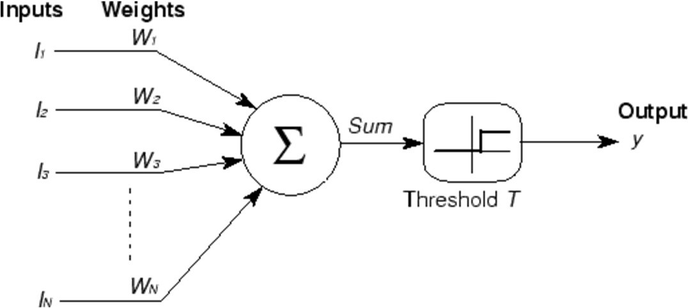
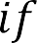
Recap: the perceptron
x₁
x₁
x₃
i i
i
x_{N}
A threshold unit
“Fires” if the weighted sum of inputs exceeds a threshold
Electrical engineers will call this a threshold gate
A basic unit of Boolean circuits
8

Slide 9
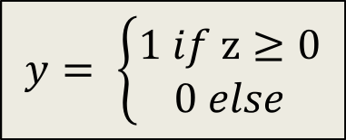
A better figure
1
1
2
i i
i
2
.
3
3
+
.
N
N
A threshold unit
– “Fires” if the weighted sum of inputs and the “bias” T is positive
9

Slide 10
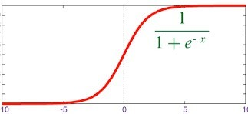
The “soft” perceptron (logistic)
1
1
i i
i
2
.
2
3
3
+
.
N
N
A “squashing” function instead of a threshold at the output
The sigmoid “activation” replaces the threshold
Activation: The function that acts on the weighted combination of inputs (and threshold)
10

Slide 11
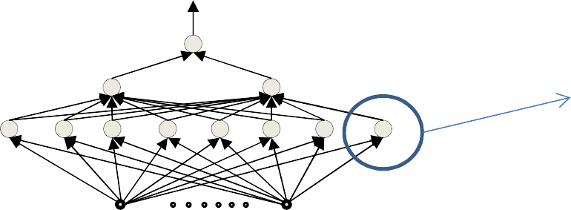
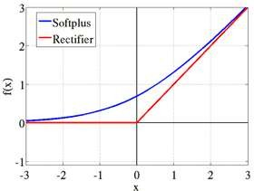
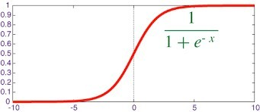
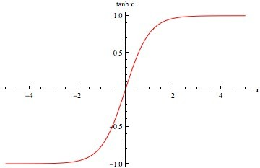
Other “activations”
x₁ x₂
𝑤₁
𝑤₂
𝑤₃
x₃
.
+
𝑧
.
𝑦
.
.
𝑤_{N}
𝑏
x_{N}
sigmoid
tanh
1
log(1 + 𝑒^{z})
tanh(𝑧)
1 + exp(−𝑧)
Does not always have to be a squashing function
– We will hear more about activations later
We will continue to assume a “threshold” activation in this lecture
11

Slide 12
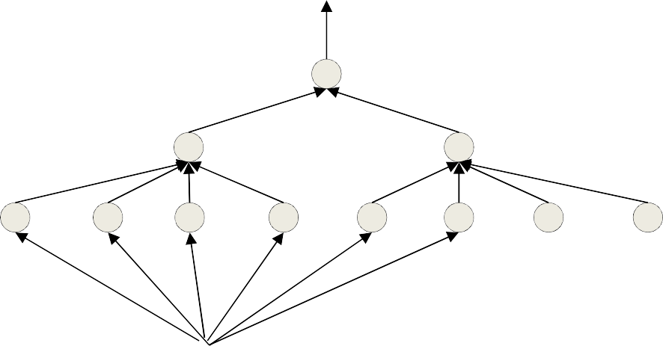
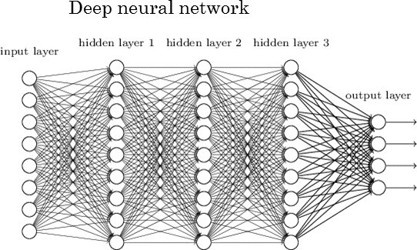

The multi-layer perceptron
A network of perceptrons
– Generally “layered”
12

Slide 13
Defining “depth”
What is a “deep” network
13

Slide 14
Deep Structures
In any directed network of computational elements with input source nodes and output sink nodes, “depth” is the length of the longest path from a source to a sink
Left: Depth = 2.
Right: Depth = 3
14

Slide 15
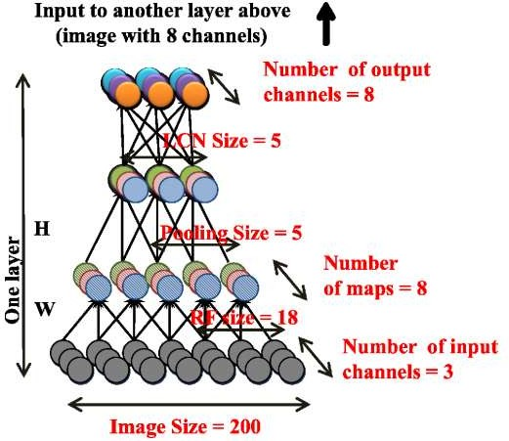
Deep Structures
Layered deep structure
“Deep” → Depth > 2
15

Slide 16
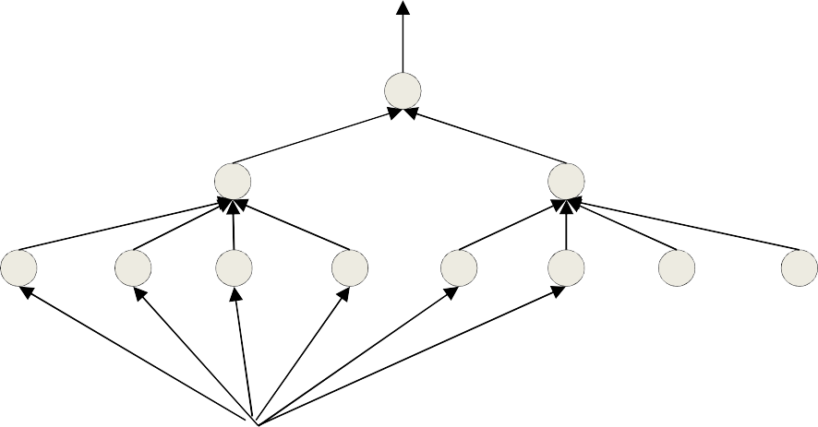
The multi-layer perceptron
N.Net
Inputs are real or Boolean stimuli
Outputs are real or Boolean values
Can have multiple outputs for a single input
What can this network compute?
What kinds of input/output relationships can it model?
16

Slide 17



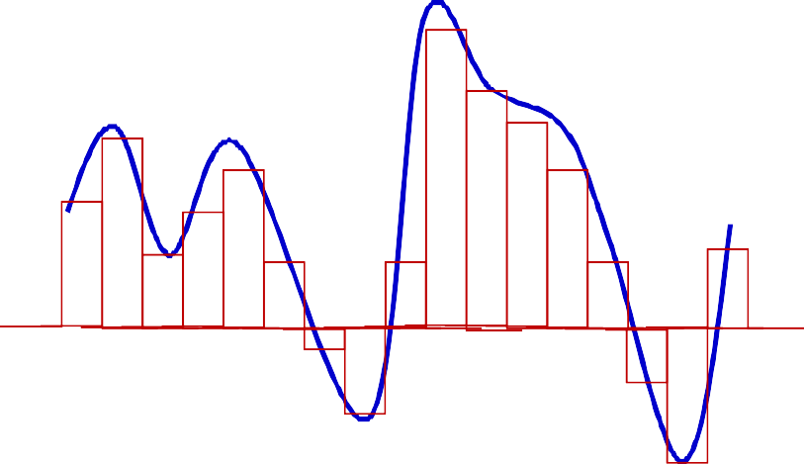
MLPs approximate functions
2
ℎ₂
1
1
0
1
ℎ_{n}
1
-1
1
1
x
2
1
2
1
2
1
1 1 1
-1 1
-1
1
X Y Z A
MLPs can compose Boolean functions
MLPs can compose real-valued functions
What are the limitations?
17

Slide 18
Today
Multi-layer Perceptrons as universal Boolean functions
The need for depth
MLPs as universal classifiers
The need for depth
MLPs as universal approximators
A discussion of optimal depth and width
Brief segue: RBF networks
18

Slide 19
Today
Multi-layer Perceptrons as universal Boolean functions
– The need for depth
MLPs as universal classifiers
– The need for depth
MLPs as universal approximators
A discussion of optimal depth and width
Brief segue: RBF networks
19

Slide 20
The MLP as a Boolean function
How well do MLPs model Boolean functions?
20

Slide 21







The perceptron as a Boolean gate
X
1
-1
2
X
0
1
Y
X
1
1
1
Y
A perceptron can model any simple binary Boolean gate

Slide 22

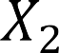


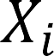


Perceptron as a Boolean gate
1
1
1
-1
-1
L
-1
Will fire only if X₁ .. X_{L} are all 1 and X_{L+1} .. X_{N} are all 0
The universal AND gate
AND any number of inputs
Any subset of who may be negated

Slide 23

Perceptron as a Boolean gate
1
1
1
-1
-1
L-N+1
-1
Will fire only if any of X₁ .. X_{L} are 1 or any of X_{L+1} .. X_{N} are 0
The universal OR gate
OR any number of inputs
Any subset of who may be negated

Slide 24
Perceptron as a Boolean Gate
1
1
Will fire only if at least K inputs are 1
1
1
1
K
1
Generalized majority gate
– Fire if at least K inputs are of the desired polarity

Slide 25
Perceptron as a Boolean Gate
1
1
1
-1
-1
Will fire only if the total number of
L-N+K
of X .. X that are 1 or X .. X
that
1 L L+1 N
are 0 is at least K
-1
Generalized majority gate
– Fire if at least K inputs are of the desired polarity

Slide 26


The perceptron is not enough
X
?
?
?
Y
Cannot compute an XOR

Slide 27




Multi-layer perceptron
X
1
1
1
-1
2
1
1
-1
-1
Y
Hidden Layer
MLPs can compute the XOR

Slide 28
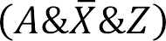

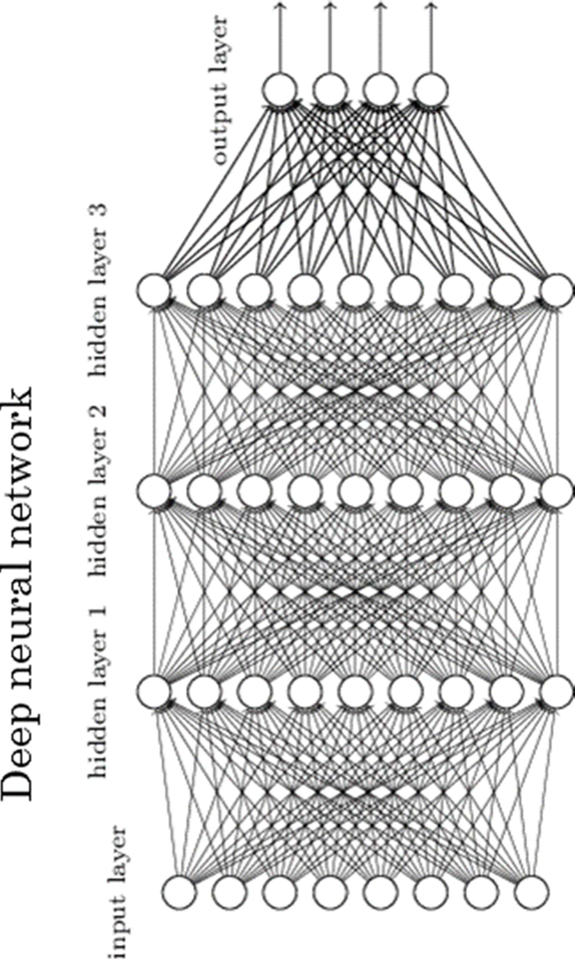
MLP as Boolean Functions
2
1
1
0
1
1
-1
1
1
2
1
2
1
1
1 1 1
-1 1
-1
1
1
X
Y
Z
A
MLPs are universal Boolean functions
– Any function over any number of inputs and any number of outputs
But how many “layers” will they need?
29

Slide 29
How many layers for a Boolean MLP?
Truth table shows all input combinations
Truth Table
for which output is 1
X₁ | X₂ | X₃ | X₄ | X₅ | Y
0 | 0 | 1 | 1 | 0 | 1
0 | 1 | 0 | 1 | 1 | 1
0 | 1 | 1 | 0 | 0 | 1
1 | 0 | 0 | 0 | 1 | 1
1 | 0 | 1 | 1 | 1 | 1
1 | 1 | 0 | 0 | 1 | 1
A Boolean function is just a truth table
39

Slide 30

How many layers for a Boolean MLP?
Truth table shows all input combinations
Truth Table
for which output is 1
X₁ | X₂ | X₃ | X₄ | X₅ | Y
0 | 0 | 1 | 1 | 0 | 1
0 | 1 | 0 | 1 | 1 | 1
0 | 1 | 1 | 0 | 0 | 1
1 | 0 | 0 | 0 | 1 | 1
1 | 0 | 1 | 1 | 1 | 1
1 | 1 | 0 | 0 | 1 | 1
1 2 3 4 5
1 2 3 4 5
1 2 3 4 5
1 2 3 4 5
1 2 3 4 5
1 2 3 4 5
Expressed in disjunctive normal form

Slide 31
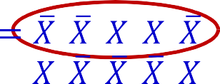
How many layers for a Boolean MLP?
Truth table shows all input combinations
Truth Table
for which output is 1
X₁ | X₂ | X₃ | X₄ | X₅ | Y
0 | 0 | 1 | 1 | 0 | 1
0 | 1 | 0 | 1 | 1 | 1
0 | 1 | 1 | 0 | 0 | 1
1 | 0 | 0 | 0 | 1 | 1
1 | 0 | 1 | 1 | 1 | 1
1 | 1 | 0 | 0 | 1 | 1
1 2 3 4 5
1 2 3 4 5
1 2 3 4 5
1 2 3 4 5
1 2 3 4 5
1 2 3 4 5
X₁ X₂ X₃ X₄
Expressed in disjunctive normal form
X₅

Slide 32

How many layers for a Boolean MLP?
Truth table shows all input combinations
Truth Table
for which output is 1
X₁ | X₂ | X₃ | X₄ | X₅ | Y
0 | 0 | 1 | 1 | 0 | 1
0 | 1 | 0 | 1 | 1 | 1
0 | 1 | 1 | 0 | 0 | 1
1 | 0 | 0 | 0 | 1 | 1
1 | 0 | 1 | 1 | 1 | 1
1 | 1 | 0 | 0 | 1 | 1
1 2 3 4 5
1 2 3 4 5
1 2 3 4 5
1 2 3 4 5
1 2 3 4 5
1 2 3 4 5
X₁ X₂ X₃ X₄
Expressed in disjunctive normal form
X₅

Slide 33
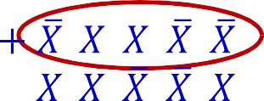

How many layers for a Boolean MLP?
Truth table shows all input combinations
Truth Table
for which output is 1
X₁ | X₂ | X₃ | X₄ | X₅ | Y
0 | 0 | 1 | 1 | 0 | 1
0 | 1 | 0 | 1 | 1 | 1
0 | 1 | 1 | 0 | 0 | 1
1 | 0 | 0 | 0 | 1 | 1
1 | 0 | 1 | 1 | 1 | 1
1 | 1 | 0 | 0 | 1 | 1
1 2 3 4 5
1 2 3 4 5
1 2 3 4 5
1 2 3 4 5
1 2 3 4 5
1 2 3 4 5
X₁ X₂ X₃ X₄
Expressed in disjunctive normal form
X₅

Slide 34
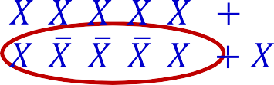
How many layers for a Boolean MLP?
Truth table shows all input combinations
Truth Table
for which output is 1
X₁ | X₂ | X₃ | X₄ | X₅ | Y
0 | 0 | 1 | 1 | 0 | 1
0 | 1 | 0 | 1 | 1 | 1
0 | 1 | 1 | 0 | 0 | 1
1 | 0 | 0 | 0 | 1 | 1
1 | 0 | 1 | 1 | 1 | 1
1 | 1 | 0 | 0 | 1 | 1
 | 1 |  | 2 3 | 4 |  | 5 |  | 1 |  | 2 |  | 3 4 | 5 |  |  |  | 1 | 2 |  | 3 |  | 4 |  | 5
 | 1 |  | 2 3 | 4 |  | 5 |  | 1 |  | 2 |  | 3 4 | 5 |  |  |  | 1 | 2 |  | 3 |  | 4 |  | 5
X₁ X₂ X₃ X₄
Expressed in disjunctive normal form
X₅

Slide 35
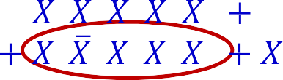
How many layers for a Boolean MLP?
Truth table shows all input combinations
Truth Table
for which output is 1
X₁ | X₂ | X₃ | X₄ | X₅ | Y
0 | 0 | 1 | 1 | 0 | 1
0 | 1 | 0 | 1 | 1 | 1
0 | 1 | 1 | 0 | 0 | 1
1 | 0 | 0 | 0 | 1 | 1
1 | 0 | 1 | 1 | 1 | 1
1 | 1 | 0 | 0 | 1 | 1
 | 1 |  | 2 3 |  | 4 |  | 5 |  |  |  | 1 | 2 |  | 3 4 | 5 |  | 1 | 2 |  | 3 |  | 4 |  | 5
 | 1 |  | 2 3 |  | 4 |  | 5 |  |  |  | 1 | 2 |  | 3 4 | 5 |  | 1 | 2 |  | 3 |  | 4 |  | 5
X₁ X₂ X₃ X₄
Expressed in disjunctive normal form
X₅

Slide 36
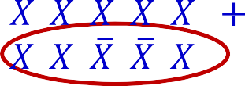
How many layers for a Boolean MLP?
Truth table shows all input combinations
Truth Table
for which output is 1
X₁ | X₂ | X₃ | X₄ | X₅ | Y
0 | 0 | 1 | 1 | 0 | 1
0 | 1 | 0 | 1 | 1 | 1
0 | 1 | 1 | 0 | 0 | 1
1 | 0 | 0 | 0 | 1 | 1
1 | 0 | 1 | 1 | 1 | 1
1 | 1 | 0 | 0 | 1 | 1
1 2 3 4 5
1 2 3 4 5
1 2 3 4 5
1 2 3 4 5
1 2 3 4 5
1 2 3 4 5
X₁ X₂ X₃ X₄
Expressed in disjunctive normal form
X₅

Slide 37
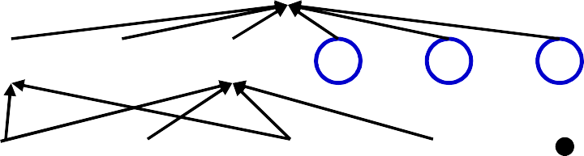
How many layers for a Boolean MLP?
Truth table shows all input combinations
Truth Table
for which output is 1
X₁ | X₂ | X₃ | X₄ | X₅ | Y
0 | 0 | 1 | 1 | 0 | 1
0 | 1 | 0 | 1 | 1 | 1
0 | 1 | 1 | 0 | 0 | 1
1 | 0 | 0 | 0 | 1 | 1
1 | 0 | 1 | 1 | 1 | 1
1 | 1 | 0 | 0 | 1 | 1
1 2 3 4 5
1 2 3 4 5
1 2 3 4 5
1 2 3 4 5
1 2 3 4 5
1 2 3 4 5
X₁ X₂ X₃ X₄
Expressed in disjunctive normal form
X₅

Slide 38
How many layers for a Boolean MLP?
Truth table shows all input combinations
Truth Table
for which output is 1
X₁ | X₂ | X₃ | X₄ | X₅ | Y
0 | 0 | 1 | 1 | 0 | 1
0 | 1 | 0 | 1 | 1 | 1
0 | 1 | 1 | 0 | 0 | 1
1 | 0 | 0 | 0 | 1 | 1
1 | 0 | 1 | 1 | 1 | 1
1 | 1 | 0 | 0 | 1 | 1
1 2 3 4 5
1 2 3 4 5
1 2 3 4 5
1 2 3 4 5
1 2 3 4 5
1 2 3 4 5
X₁ X₂ X₃ X₄ X₅
Any truth table can be expressed in this manner!
A one-hidden-layer MLP is a Universal Boolean Function

Slide 39
How many layers for a Boolean MLP?
Truth table shows all input combinations
Truth Table
for which output is 1
X₁ | X₂ | X₃ | X₄ | X₅ | Y
0 | 0 | 1 | 1 | 0 | 1
0 | 1 | 0 | 1 | 1 | 1
0 | 1 | 1 | 0 | 0 | 1
1 | 0 | 0 | 0 | 1 | 1
1 | 0 | 1 | 1 | 1 | 1
1 | 1 | 0 | 0 | 1 | 1
1 2 3 4 5
1 2 3 4 5
1 2 3 4 5
1 2 3 4 5
1 2 3 4 5
1 2 3 4 5
X₁ X₂ X₃ X₄ X₅
Any truth table can be expressed in this manner!
A one-hidden-layer MLP is a Universal Boolean Function
But what is the largest number of perceptrons required in the single hidden layer for an N-input-variable function?
40

Slide 40
Reducing a Boolean Function
YZ
WX
00 01 11 10
00
This is a “Karnaugh Map”
It represents a truth table as a grid Filled boxes represent input combinations for which output is 1; blank boxes have output 0
Adjacent boxes can be “grouped” to reduce the complexity of the DNF formula for the table
01
11
10
DNF form:
Find groups
Express as reduced DNF

Slide 41
Reducing a Boolean Function
YZ
WX
00 01 11 10
00
Basic DNF formula will require 7 terms
01
11
10

Slide 42
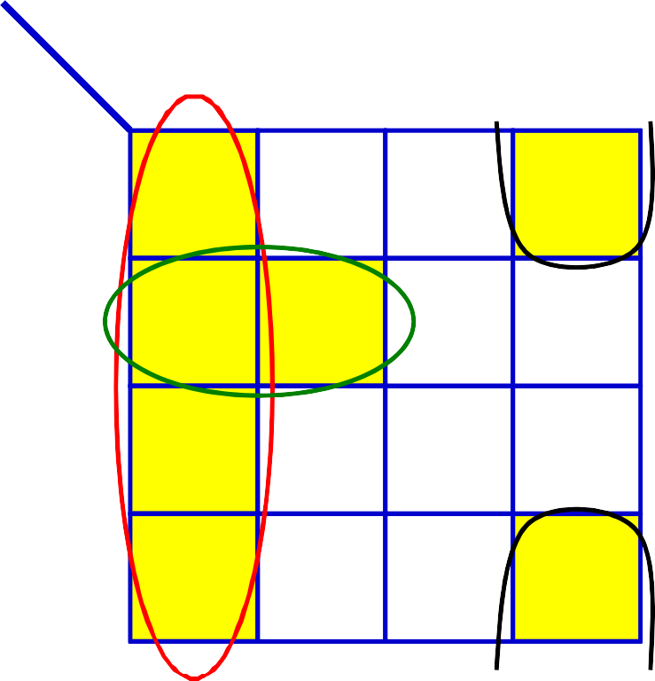




Reducing a Boolean Function
YZ
WX
00 01 11 10
00
01
11
10
Reduced DNF form:
Find groups
Express as reduced DNF

Slide 43
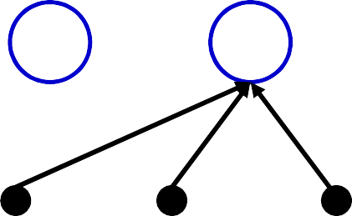

Reducing a Boolean Function
YZ
WX
00 01 11 10
00
01
11
10
W X
Y
Z
Reduced DNF form:
Find groups
Express as reduced DNF
Boolean network for this function needs only 3 hidden units
Reduction of the DNF reduces the size of the one-hidden-layer network
44

Slide 44
Largest irreducible DNF?
YZ
WX
00
00 01 11 10
01
11
10
What arrangement of ones and zeros simply cannot be reduced further?
45

Slide 45
Largest irreducible DNF?
YZ
WX
00
00 01 11 10
01
11
10
•
What arrangement of ones and zeros simply
cannot be reduced further?

Slide 46
Largest irreducible DNF?
YZ
WX
00
How many neurons in a DNF (one- hidden-layer) MLP
for this Boolean
function?
00 01 11 10
01
11
10
•
What arrangement of ones and zeros simply
cannot be reduced further?

Slide 47
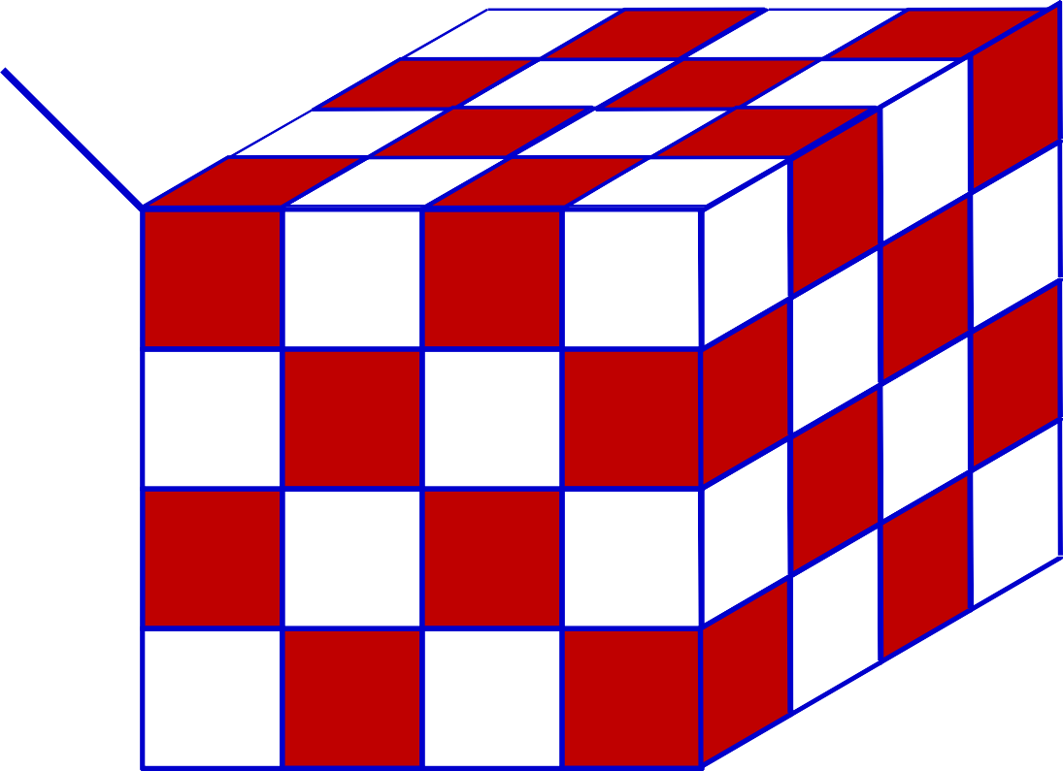
Width of a single-layer Boolean MLP
YZ
WX
00
01
11
10
10
11
01
YZ
_{UV} 00
00
01 11 10
How many neurons in a DNF (one-hidden- layer) MLP for this Boolean function of 6 variables?

Slide 48
Width of a single-layer Boolean MLP
Can be generalized: Will require 2^{N-1} perceptrons in hidden layer Exponential in N
YZ
WX
00
01
11
10
10
11
01
YZ
_{UV} 00
00
01 11 10
How many neurons in a DNF (one-hidden-
layer) MLP for this Boolean function

Slide 49
Width of a single-layer Boolean MLP
Can be generalized: Will require 2^{N-1} perceptrons in hidden layer Exponential in N
YZ
WX
00
01
11
10
10
11
01
YZ
_{UV} 00
00
01 11 10
• How many neurons in a DNF (one-hidden-
How many units if we use multiple layers?
layer) MLP for this Boolean function

Slide 50
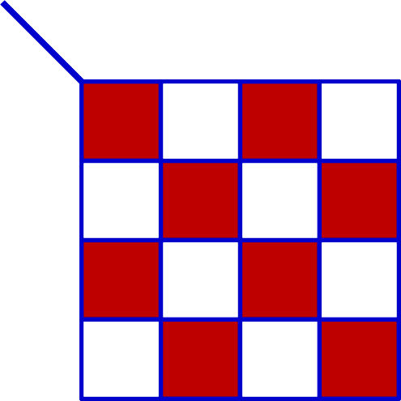
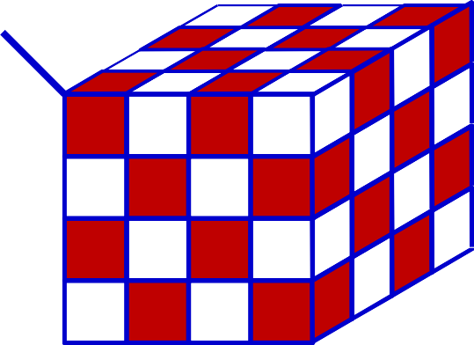








Width of a deep MLP
YZ
WX
00 01 11 10
00
WX
YZ
00
01
01
11
11
11
10
10
10
01
UV
00 01 11 10
00
YZ

Slide 51
Multi-layer perceptron XOR
X
1
1
1
-1
2
1
1
-1
-1
Y
Hidden Layer
An XOR takes three perceptrons

Slide 52
Multi-layer perceptron XOR
X
1
1
-2
1.5
0.5
1
1
Y
With 2 neurons
– 5 weights and two thresholds
53

Slide 53
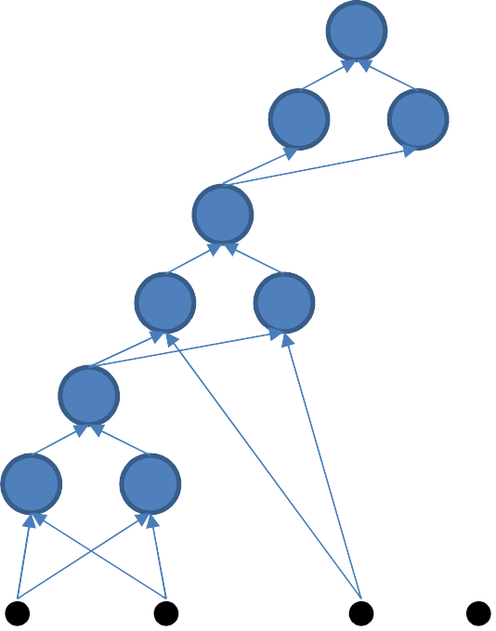
Width of a deep MLP
YZ
WX
00 01 11 10
00
01
9 perceptrons
11
10
W
X
Y
Z
An XOR needs 3 perceptrons
This network will require 3x3 = 9 perceptrons

Slide 54
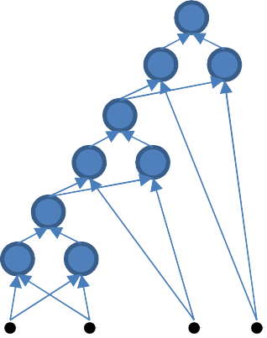
Width of a deep MLP
YZ
WX
00
01
11
11
01
YZ
10
10
_{UV} 00 01 11 10
00
U V
W X Y Z
15 perceptrons
•
•
An XOR needs 3 perceptrons
This network will require 3x5 = 15 perceptrons

Slide 55
Width of a deep MLP
YZ
WX
00
01
11
11
01
YZ
10
10
_{UV} 00 01 11 10
00
More generally, the XOR of N variables will require 3(N-1) perceptrons!!
U V
W X Y Z
•
•
An XOR needs 3 perceptrons
This network will require 3x5 = 15 perceptrons

Slide 56
Width of a single-layer Boolean MLP
YZ
WX
00
Single hidden layer: Will require 2^{N}+1 perceptrons in all (including output unit) Exponential in N
01
11
10
10
11
01
Will require 3(N-1) perceptrons in a deep network
Linear in N!!!
Can be arranged in only 2log₂(N) layers
_{UV} 00 01 11 10 ⁰⁰ YZ
• How many neurons in a DNF (one-hidden- layer) MLP for this Boolean function

Slide 57
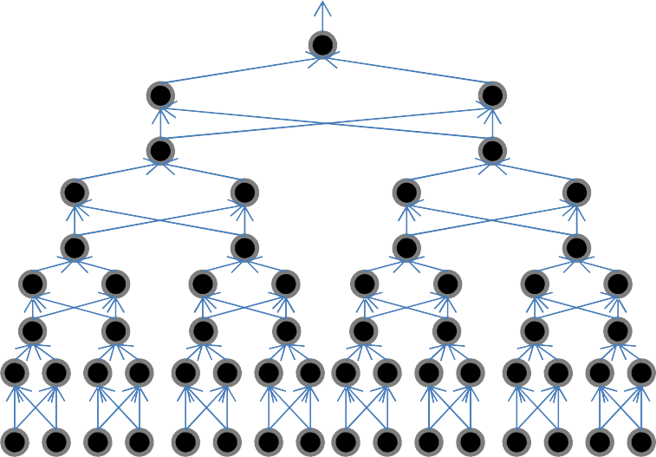






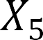
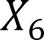
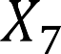
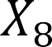
A better representation
𝑋₁
𝑋_{N}
Only layers
By pairing terms
2 layers per XOR
…

Slide 58













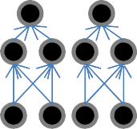



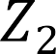

The challenge of depth
……
𝑍_{M}
𝑍₁
𝑋₁
𝑋_{N}
Using only K hidden layers will require O(2^{CN}) neurons in the Kth layer, where
–K/2
Because the output can be shown to be the XOR of all the outputs of the K-1th hidden layer
I.e. reducing the number of layers below the minimum will result in an exponentially sized network to express the function fully
A network with fewer than the minimum required number of neurons cannot model
the function
59

Slide 59
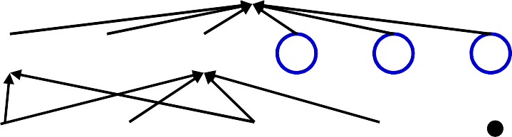

The actual number of parameters in a network
X₁ X₂ X₃ X₄ X₅
The actual number of parameters in a network is the number of
connections
– In this example there are 30
This is the number that really matters in software or hardware implementations
Networks that require an exponential number of neurons will require an exponential or superexponential number of weights..
60

Slide 60
Recap: The need for depth
Deep Boolean MLPs that scale linearly with the number of inputs …
… can become exponentially large if recast using only one layer
It gets worse..

Slide 61
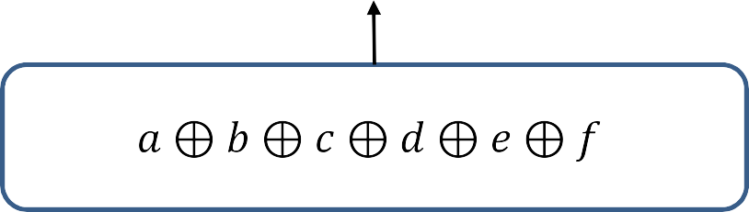

The need for depth
a
b
c
d e
f
X₁ X₂ X₃ X₄ X₅
The wide function can happen at any layer
Having a few extra layers can greatly reduce network size

Slide 62


Depth vs Size in Boolean Circuits
The XOR is really a parity problem
Any Boolean circuit of depth using AND,OR and NOT gates with unbounded fan-in must have size
Parity, Circuits, and the Polynomial-Time Hierarchy,
M. Furst, J. B. Saxe, and M. Sipser, Mathematical Systems Theory 1984
Alternately stated:
Set of constant-depth polynomial size circuits of unbounded fan-in elements

Slide 63





Note: Not all Boolean functions..
Not all Boolean circuits have such clear depth-vs-size tradeoff
Shannon’s theorem: For , there is Boolean function of variables that requires at least
gates
More correctly, for large functions need more than
Regardless of depth
,almost all n-input Boolean gates
Note: If all Boolean functions over inputs could be computed using a circuit of size that is polynomial in , P = NP!

Slide 64
Network size: summary
An MLP is a universal Boolean function
But can represent a given function only if
It is sufficiently wide
It is sufficiently deep
Depth can be traded off for (sometimes) exponential growth of the width of the network
Optimal width and depth depend on the number of variables and the complexity of the Boolean function
Complexity: minimal number of terms in DNF formula to represent it

Slide 65
Summary
Multi-layer perceptrons are Universal Boolean Machines
Even a network with a single hidden layer is a universal Boolean machine
But a single-layer network may require an exponentially large number of perceptrons
Deeper networks may require far fewer neurons than shallower networks to express the same function
Could be exponentially smaller

Slide 66
Note 2
Used a simple “Boolean circuit” analogy for explanation
We actually have threshold circuit (TC) not, just a Boolean circuit (AC)
Specifically composed of threshold gates
More versatile than Boolean gates (can compute majority function)
– E.g. “at least K inputs are 1” is a single TC gate, but an exponential size AC
– For fixed depth, 𝐵𝑜𝑜𝑙𝑒𝑎𝑛 𝑐𝑖𝑟𝑐𝑢𝑖𝑡𝑠 ⊂ 𝑡ℎ𝑟𝑒𝑠ℎ𝑜𝑙𝑑 𝑐𝑖𝑟𝑐𝑢𝑖𝑡𝑠 (strict subset)
2
– A depth-2 TC parity circuit can be composed with weights
But a network of depth log(𝑛) requires only 𝒪 𝑛 weights
– But more generally, for large , for most Boolean functions, a threshold circuit that is polynomial in at optimal depth may become exponentially large at
Other formal analyses typically view neural networks as arithmetic circuits
– Circuits which compute polynomials over any field
So lets consider functions over the field of reals
67

Slide 67

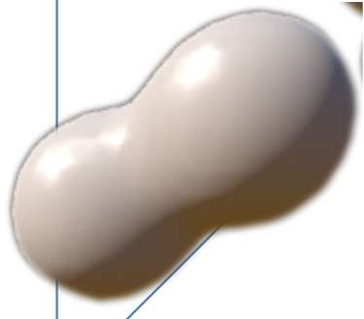


The MLP as a classifier
2
784 dimensions (MNIST)
784 dimensions
MLP as a function over real inputs
MLP as a function that finds a complex “decision boundary” over a space of reals
69

Slide 68

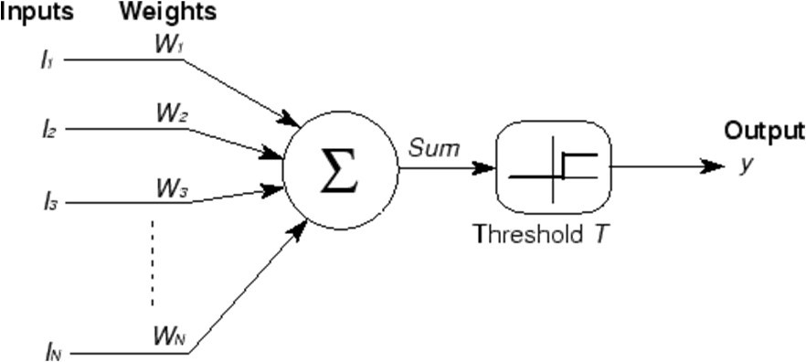




A Perceptron on Reals
x₁
1
x₂
x₃
x
0
w x +w x =T
2
1 1 2 2
x_{N}
x₁
i i
i
A perceptron operates on
real-valued vectors
x₂
x₁
– This is a linear classifier
70

Slide 69















Boolean functions with a real perceptron
0,1
1,1
0,1
1,1
0,1
1,1
X
Y
X
0,0
Y
1,0
0,0
X
1,0
0,0
Y
1,0
Boolean perceptrons are also linear classifiers
– Purple regions are 1
71

Slide 70
Composing complicated “decision” boundaries
x
Can now be composed into “networks” to compute arbitrary classification “boundaries”
2
x₁
Build a network of units with a single output that fires if the input is in the coloured area
72

Slide 71

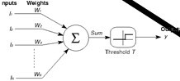
Booleans over the reals
x₂
x₁
x₂
x₁
The network must fire if the input is in the coloured area
73

Slide 72
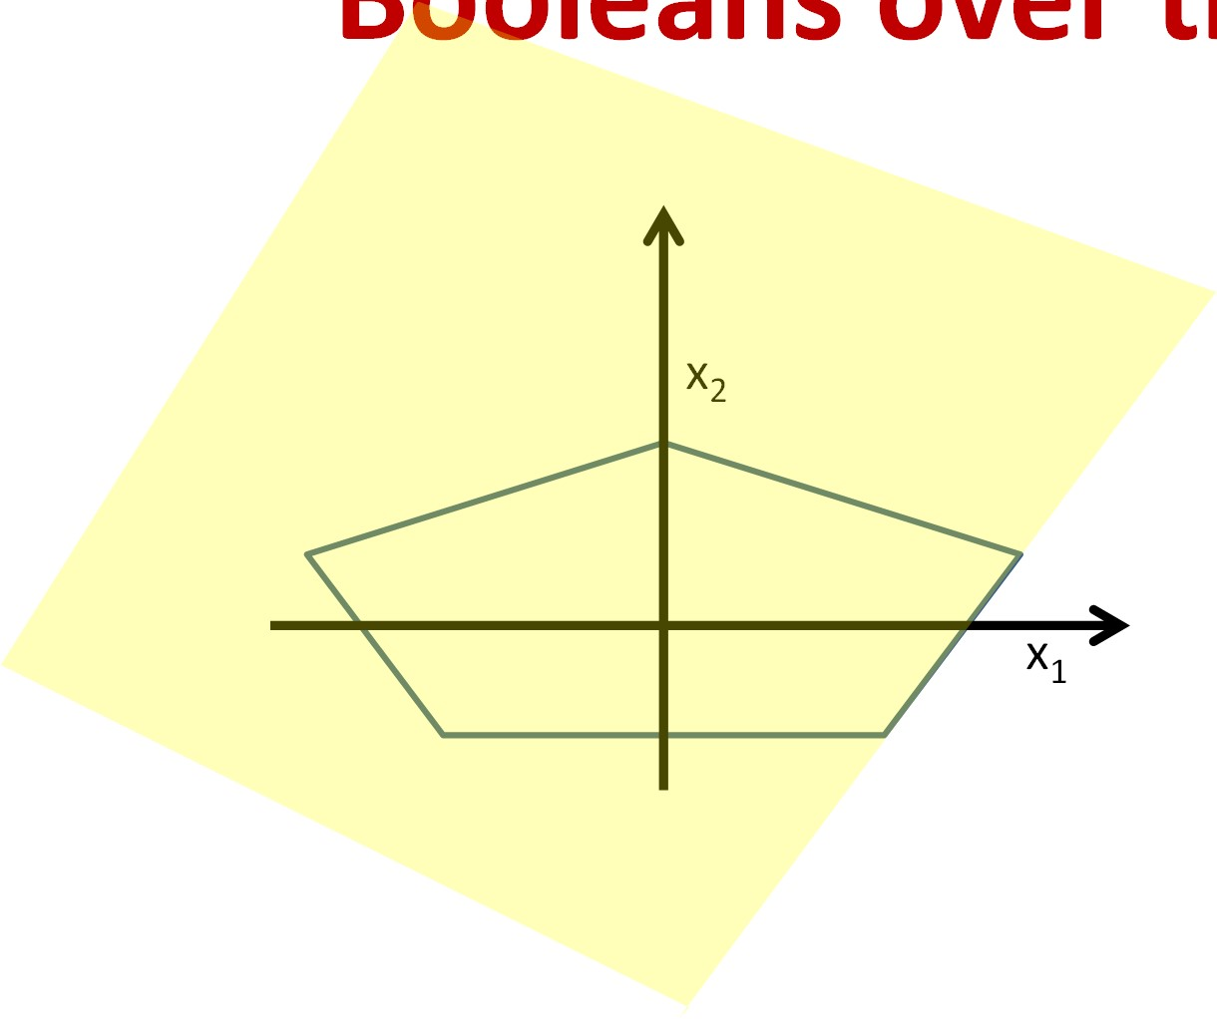
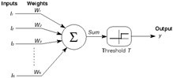
he reals
Booleans over t
x₂
x₁
x₂
x₁
The network must fire if the input is in the coloured area
74

Slide 73
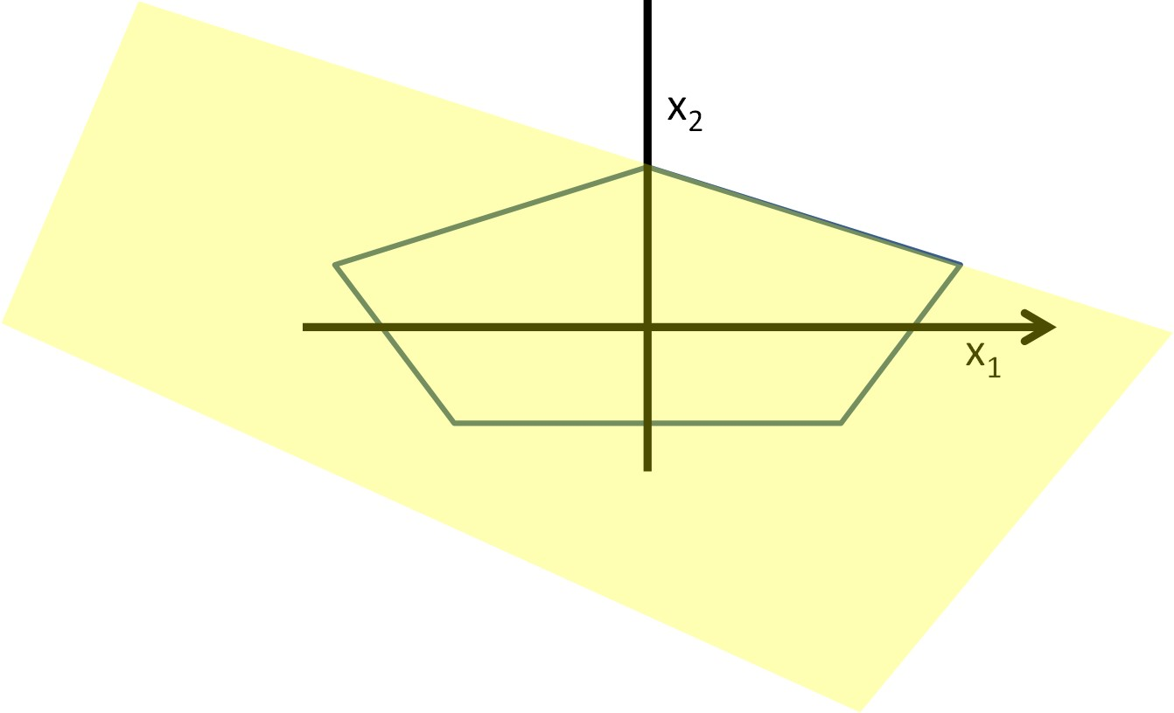
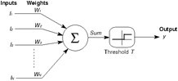
Booleans over the reals
x₂
x
1
x₂
x₁
The network must fire if the input is in the coloured area
75

Slide 74


Booleans over the reals
x₂
x₁
x₂
x₁
The network must fire if the input is in the coloured area
76

Slide 75



Booleans over the reals
x₂
x₁
x₂
x₁
The network must fire if the input is in the coloured area
77

Slide 76






he reals
Booleans over t
x₂
x₁
3
N
x
i
4
2
i=1
AND
4
3
3
5
y₁ y₂ y₃ y₄ y₅
4
x₁
4
3
3
4
x₂
x₁
The network must fire if the input is in the coloured area
78

Slide 77

More complex decision boundaries
OR
AND
AND
x₂
x₁
x₁ x₂
Network to fire if the input is in the yellow area
“OR” two polygons
A third layer is required
79

Slide 78


Complex decision boundaries
Can compose arbitrarily complex decision boundaries
80

Slide 79






Complex decision boundaries
OR
AND
x₁ x₂
Can compose arbitrarily complex decision boundaries

Slide 80
Complex decision boundaries
OR
AND
x₁ x₂
Can compose arbitrarily complex decision boundaries
With only one hidden layer!
How?

Slide 81













Exercise: compose this with one hidden layer
x₂
x₁
x₁ x₂
How would you compose the decision boundary to the left with only one hidden
layer?

Slide 82



Depth and the universal classifier
x₂
x₁
x₁ x₂
Deeper networks can require far fewer neurons

Slide 83

Optimal depth..
Formal analyses typically view these as category of
arithmetic circuits
Compute polynomials over any field
Valiant et. al: A polynomial of degree n requires a network of
depth
2
Cannot be computed with shallower networks
The majority of functions are very high (possibly ∞) order polynomials
Bengio et. al: Shows a similar result for sum-product networks
But only considers two-input units
Generalized by Mhaskar et al. to all functions that can be expressed as a binary tree
– Depth/Size analyses of arithmetic circuits still a research problem

Slide 84
Depth: Summary
The number of neurons required in a shallow network is potentially exponential in the dimensionality of the input
(this is the worst case)
Alternately, exponential in the number of statistically independent features
114

Slide 85
Summary
Multi-layer perceptrons are Universal Boolean Machines
Even a network with a single hidden layer is a universal Boolean machine
Multi-layer perceptrons are Universal Classification Functions
Even a network with a single hidden layer is a universal classifier
But a single-layer network may require an exponentially large number of perceptrons than a deep one
Deeper networks may require far fewer neurons than shallower networks to express the same function
Could be exponentially smaller
Deeper networks are more expressive
115

Slide 86


“Proper” networks: Outputs with activations
x₁ x₂ x₃
x_{N}
sigmoid
tanh
Output neuron may have actual “activation”
– Threshold, sigmoid, tanh, softplus, rectifier, etc.
What is the property of such networks?
122

Slide 87









The network as a function
N
N N N
N
Output unit with activation function
Threshold or Sigmoid, or any other
The network is actually a universal map from the entire domain of input values to the entire range of the output activation
All values the activation function of the output neuron
123

Slide 88
The network as a function
N
N N N
N
The MLP is a Universal Approximator for the entire class of functions (maps) it represents!
• Output unit with activation function
– Threshold or Sigmoid, or any other
The network is actually a universal map from the entire domain of input values to the entire range of the output activation
– All values the activation function of the output neuron
124

Slide 89
Multi-layer Perceptrons as universal Boolean functions
The need for depth
MLPs as universal classifiers
The need for depth
MLPs as universal approximators
A discussion of optimal depth and width
Brief segue: RBF networks
125

Slide 90
The issue of depth
Previous discussion showed that a single-layer MLP is a universal function approximator
Can approximate any function to arbitrary precision
But may require infinite neurons in the layer
More generally, deeper networks will require far fewer neurons for the same approximation error
The network is a generic map
The same principles that apply for Boolean networks apply here
Can be exponentially fewer than the 1-layer network
126

Slide 91
Width vs. Activations vs. Depth
Narrow layers can still pass information to subsequent layers if the activation function is sufficiently graded
But will require greater depth, to permit later layers to capture patterns
137

Slide 92
Multi-layer Perceptrons as universal Boolean functions
The need for depth
MLPs as universal classifiers
The need for depth
MLPs as universal approximators
A discussion of optimal depth and width
Brief segue: RBF networks
141

Slide 93
Conclusions
MLPs are universal Boolean function
MLPs are universal classifiers
MLPs are universal function approximators
A single-layer MLP can approximate anything to arbitrary precision
But could be exponentially or even infinitely wide in its inputs size
Deeper MLPs can achieve the same precision with far fewer neurons
Deeper networks are more expressive
148

